Slide 1

UNIT-1
Chapter 1.1
Introduction to Microcontrollers

Slide 2
Introduction to Microcontrollers:
A Microcontroller is a programmable digital processor with necessary peripherals. Both microcontrollers and microprocessors are complex sequential digital circuits meant to carry out job according to the program / instructions. Sometimes analog input/output interface makes a part of microcontroller circuit of mixed mode (both analog and digital nature).
Development/Classification of microcontrollers
Microcontrollers have gone through a silent evolution (invisible). The evolution can be rightly termed as silent as the impact or application of a microcontroller is not well known to a common user, although microcontroller technology has undergone significant change since early 1970's. Development of some popular microcontrollers is given as follows.

Slide 3
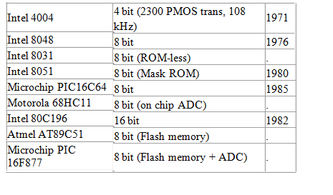
Microprocessors have undergone significant evolution over the past four decades. This development is clearly perceptible to a common user, especially, in terms of phenomenal growth in capabilities of personal computers. Development of some of the microprocessors can be given as follows.

Slide 4
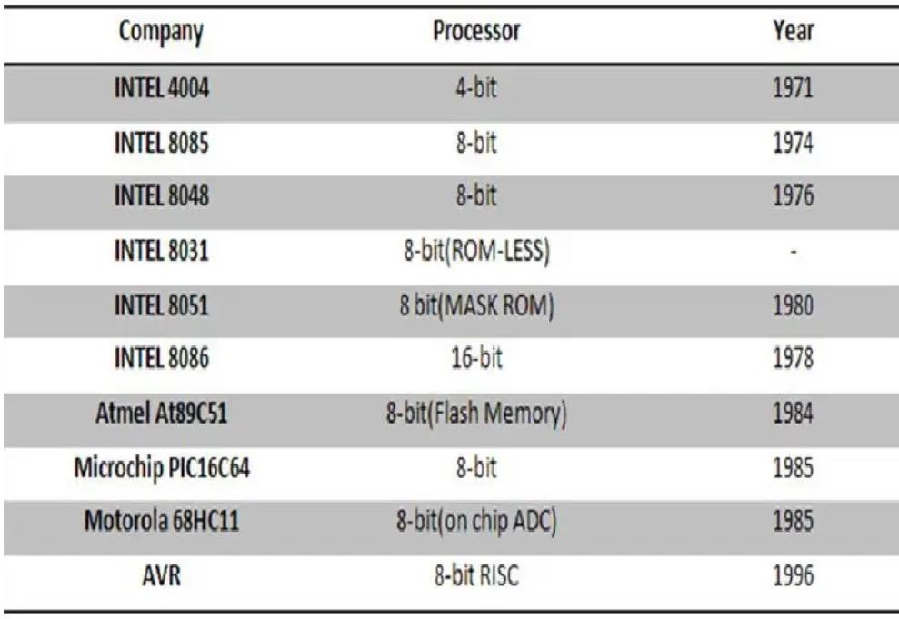
The usage in number of microcontrollers is more as compared to microprocessors. Microprocessors are primarily used for computational purpose, whereas microcontrollers find wide application in devices needing real time processing / control.
Application of microcontrollers are numerous. Starting from domestic applications such as in washing machines, TVs, Air-conditioners, microcontrollers are used in automobiles, process control industries, cell phones, electrical drives, robotics and in space applications.

Slide 5
Microcontroller
A microcontroller (MCU) is a small computer on a single integrated circuit that is designed to control specific tasks within electronic systems. It combines the functions of a central processing unit (CPU), memory, and input/output interfaces, all on a single chip.
Microcontrollers are widely used in embedded systems, such as home appliances, automotive systems, medical devices, and industrial control systems. They are also used in consumer electronics products, such as gaming systems, digital cameras, and audio players.
A typical microcontroller consists of a processor core, volatile and non-volatile memory, input/output peripherals, and various communication interfaces. The processor core is responsible for executing instructions and controlling the other components of the microcontroller. The memory is used to store data and program code, while the input/output peripherals are used to interact with the external environment.

Slide 6
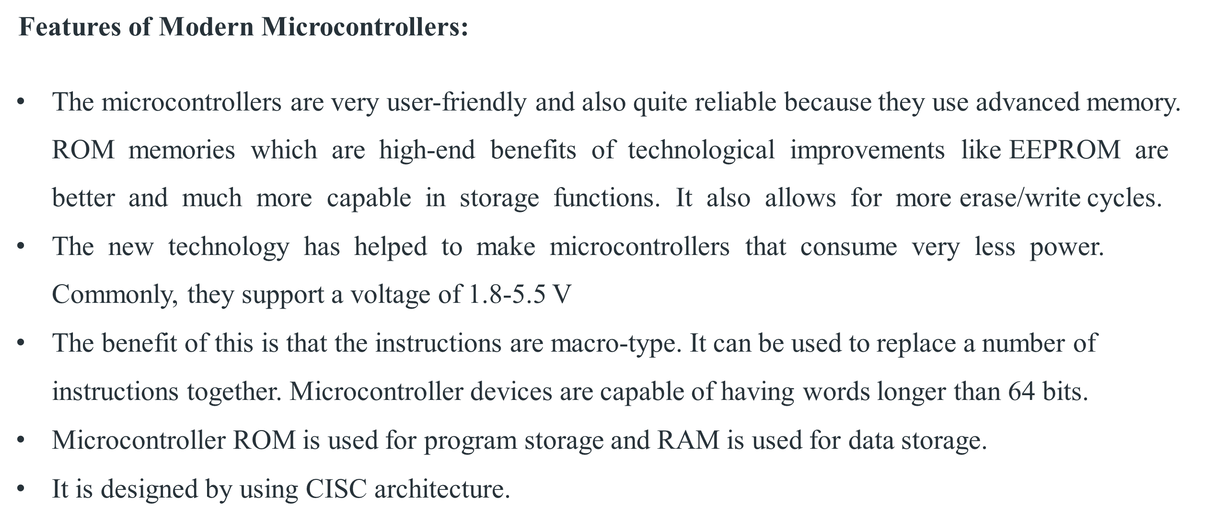

Slide 7
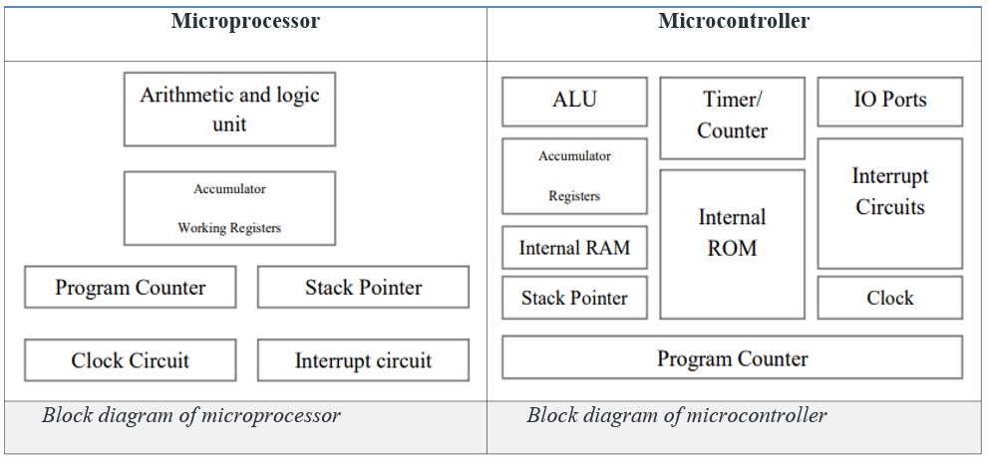
Comparing Microprocessors and Microcontrollers

Slide 8
Microprocessor contains ALU, General purpose registers, stack pointer, program counter, clock timing circuit, interrupt circuit | Microcontroller contains the circuitry of microprocessor, and in addition it has built in ROM, RAM, I/O Devices, Timers/Counters etc.
It has many instructions to move data between memory and CPU | It has few instructions to move data between memory and CPU
Few bit handling instruction | It has many bit handling instructions
Less number of pins are multifunctional | More number of pins are multifunctional
Single memory map for data and code (program) | Separate memory map for data and code (program)
Access time for memory and IO are more | Less access time for built in memory and IO.
Microprocessor based system requires additional hardware | It requires less additional hardware
More flexible in the design point of view | Less flexible since the additional circuits which is residing inside the microcontroller is fixed for a particular microcontroller
Large number of instructions with flexible addressing modes | Limited number of instructions with few addressing modes

Slide 9
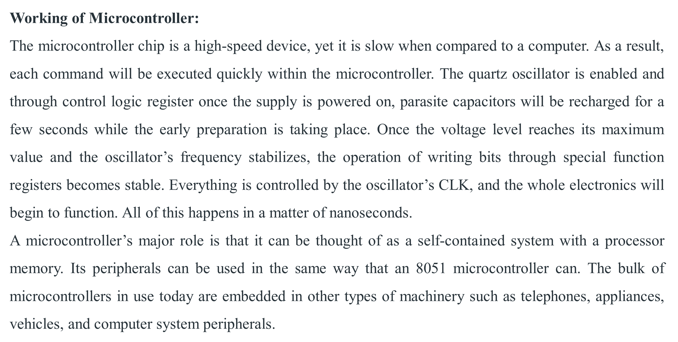

Slide 10
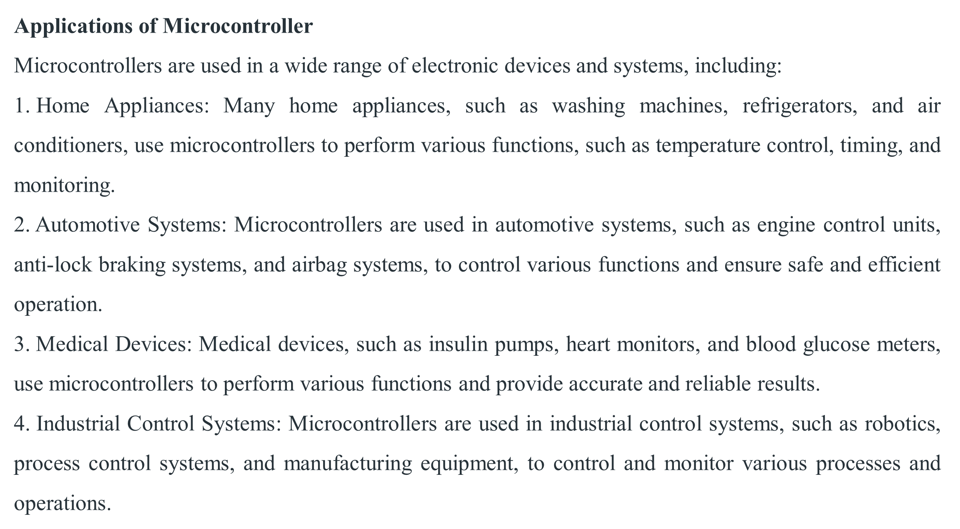

Slide 11
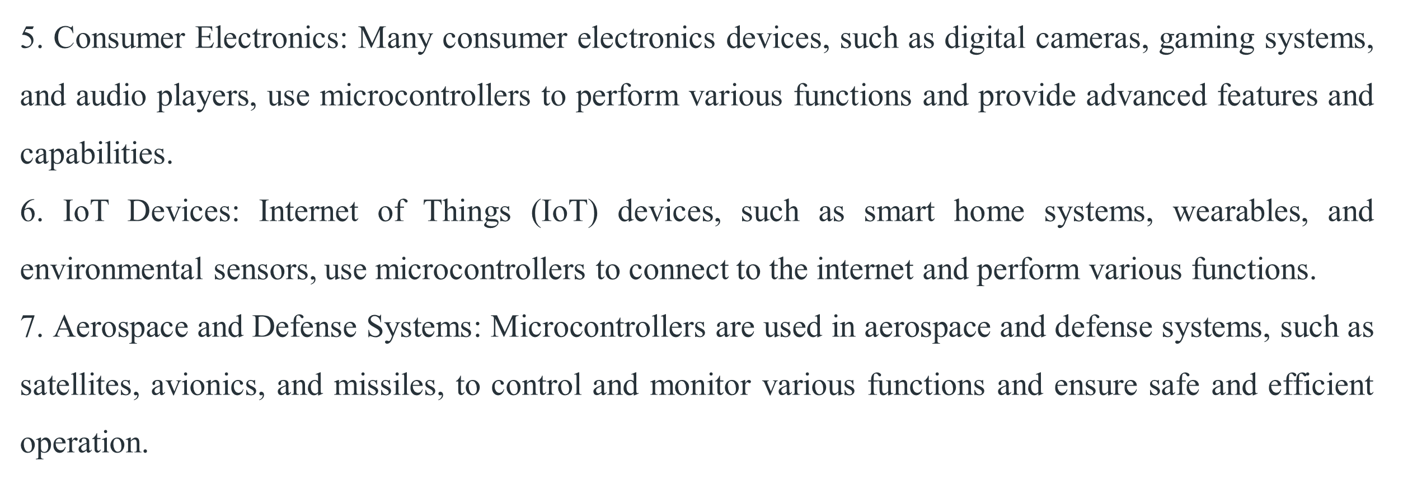

Slide 12
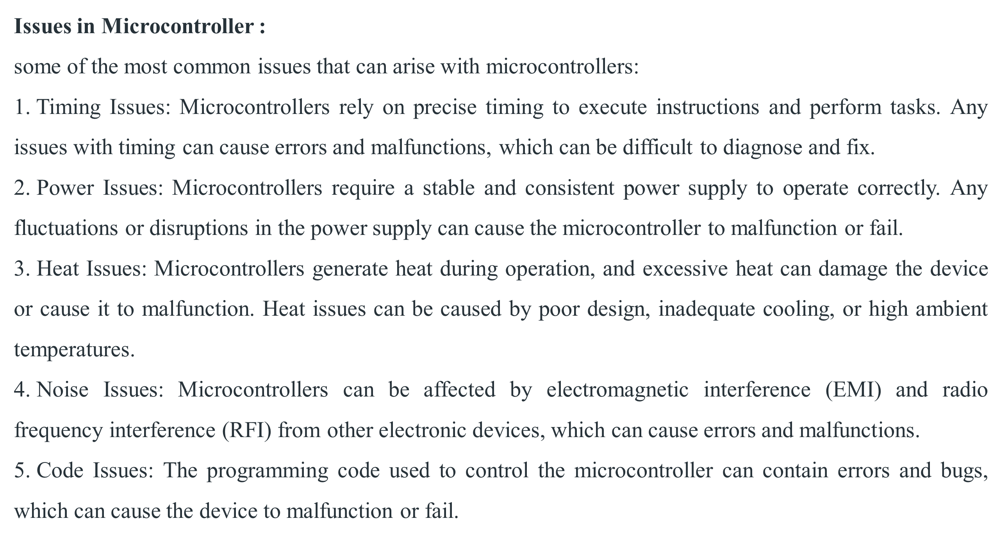

Slide 13
TEXTBOOKS/REFERENCE BOOKS
  TEXTBOOKS
T1 Kenneth Ayala, The 8051 Microcontroller, Cengage Learning India, 3rd Edition, Nov 2007
T2 B. Kanta Rao, Embedded Systems, PHI, 1st Edition, January 2011
T3 John Boxall, Arduino Workshop: A Hands-On Introduction with 65 Projects, No Starch Press, 1st Edition, May 2013
  REFERENCE BOOKS
R1 B. Ram, Fundamentals of Microprocessors and Microcontrollers, DRP, 8th Edition, Nov 2021
R2 Massimo Banzi, Getting Started with Arduino, Make Community LLC, 3rd Edition, Jan 2015
R3 Jeremy Blum, Exploring Arduino: Tools and Techniques for Engineering Wizardry, Wiley, 1st Edition, Aug 2013
Video Links:
https://www.youtube.com/watch?v=dcNk0urQsQM
https://www.youtube.com/watch?v=EUrcjGRAxyI
https://www.youtube.com/watch?v=xStSCpVTWYQ

